Slide 1
An Analysis of the Impact of Diabetes on Overall Health
By: Jedediah Brough

Slide 2
Dataset Summary
For this project, I used a dataset that looked at health factors in women among the Pima Indian tribe. The dataset has 768 observations with 9 variables to work with. The data is limited because of the specific way that it was collected. Applying findings from this dataset to other populations might be seen as extrapolation.
I will look at how the variables affect each other, specifically those that are easier to control with lifestyle changes. Pedigree can’t be changed, but changes in diet and activity level can have an effect on BMI, blood pressure, and others. I will determine how lowering BMI might have an effect on blood pressure or glucose. I will be able to filter the data by diabetes outcome to see how those interactions change based on the diagnosis of the individual.
Dataset was downloaded from Kaggle.com.

Slide 3
Explanation of Dataset Variables
The variables include:
Pregnancies – The number of pregnancies that an individual has had at the time that the data was collected.
Glucose – Glucose concentration 2 hours after an oral glucose test
Blood Pressure – Diastolic blood pressure of individual
Skin Thickness – Result of a triceps skinfold thickness test
Insulin – Insulin levels after a glucose test
BMI – Body mass index result of each individual
Diabetes Pedigree Function – Score based on family history with diabetes
Age- Age (years)
Outcome – Diabetes diagnosis. 1 for positive diagnosis and 0 for negative

Slide 4
Variable Histograms

Slide 5
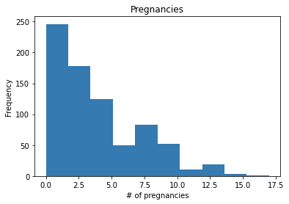
Pregnancies
Central Tendency: The values look like they cluster around the 0-2 range
Modes: There seems to be only one cluster
Spread: The data ranges all the way from 0 to 17
Tails: The data does not drop off very quickly
Outliers: There is an extreme value at 17. Study shows that more than 15 pregnancies is unlikely

Slide 6
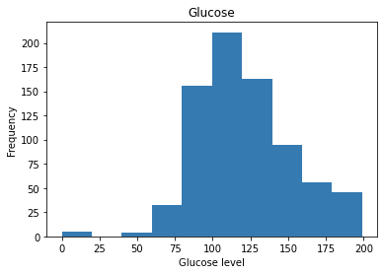
Glucose
Central Tendency: The values cluster around the 100-125 range
Modes: There is only one cluster
Spread: The data ranges from 0 to 200
Tails: The data seems to drop of relatively quickly
Outliers: There is a gap between 50 and 0. The data at 0 could be an outlier. A glucose level of 0 seems unlikely

Slide 7
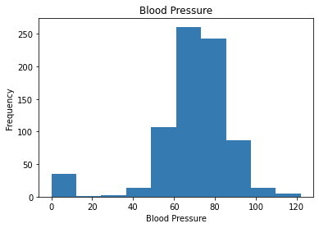
Blood Pressure
Central Tendency: The values cluster around 70
Modes: There is only one cluster
Spread: The data ranges from 0 to 120
Tails: The data seems to drop of relatively quickly
Outliers: There is a gap between 40 and 0. The data at 0 could be an outlier. Blood pressure of 0 would indicate death, so it is unlikely.

Slide 8
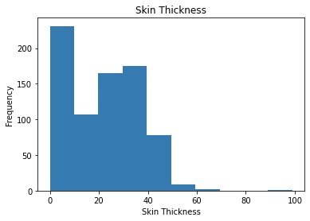
Skin Thickness
Central Tendency: The values cluster around 30
Modes: There is only one cluster
Spread: The data ranges from 0 to 90
Tails: The data does not drop off very quickly
Outliers: There is a gap between 60 and 90. The data at 90 could be an outlier

Slide 9
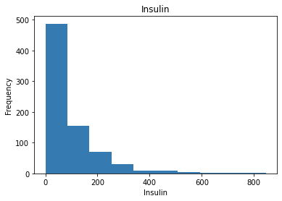
Insulin
Central Tendency: The values cluster around 0
Modes: There is only one cluster
Spread: The data ranges from 0 to 800
Tails: The data seems to drop of relatively quickly
Outliers: It doesn't look like there are any outliers

Slide 10
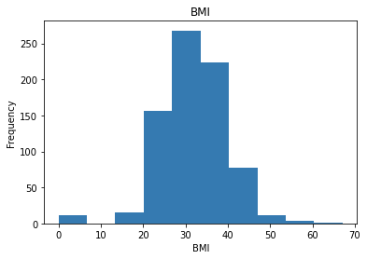
BMI
Central Tendency: The values cluster around 30-40
Modes: There is only one cluster
Spread: The data ranges from 0 to 70
Tails: The data seems to drop of relatively quickly
Outliers: There is a gap between 15 and 0. The data at 0 could be an outlier. A BMI of 0 is not possible so it is most likely an outlier

Slide 11
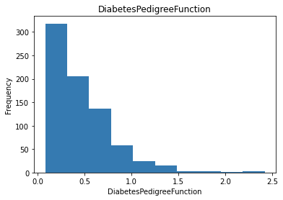
Diabetes Pedigree Function
Central Tendency: The values cluster around 0
Modes: There is only one cluster
Spread: The data ranges from 0 to 2.5
Tails: The data seems to drop of relatively quickly
Outliers: It doesn't look like there are any outliers

Slide 12
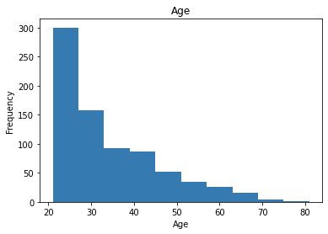
Age
Central Tendency: The values cluster around 0
Modes: There is only one cluster
Spread: The data ranges from 0 to 80
Tails: The data seems to drop of relatively quickly
Outliers: It doesn't look like there are any outliers

Slide 13
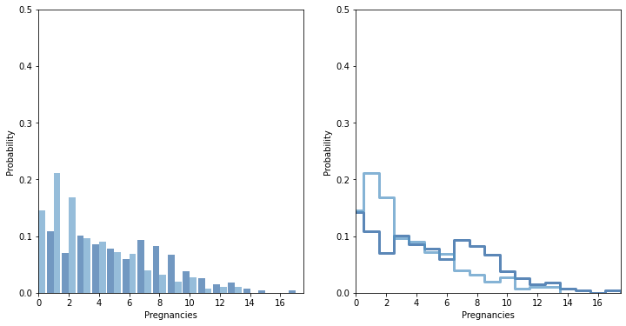
The dark blue represents pregnancies for individuals diagnosed with diabetes and the light blue represents pregnancies for individuals who have not been diagnosed with diabetes.
PMF Comparison Using Diabetes Diagnosis as a Filter

Slide 14
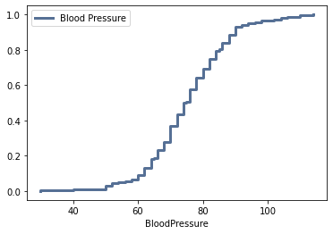
CDF for Blood Pressure in Diabetic Individuals
The CDF shows that around 20% of the diabetes cases happened in women with a blood pressure of around 60.

Slide 15
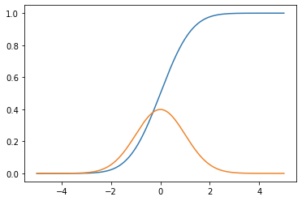
Comparison of Data to a Standard Analytical Distribution
This is a standard normal distribution
The Blue line is the CDF and the orange line is the PDF
This applies to the dataset because many of the variables follow a normal distribution.
The CDF of this standard normal and the CDF of Blood pressure from the last slide are almost identical.

Slide 16
Scatter Plots Comparing Variables

Slide 17
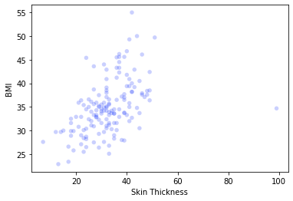
Skin Thickness vs. BMI
Covariance is 27.32664000000001
Pearson’s correlation is 0.46563175676821433

Slide 18
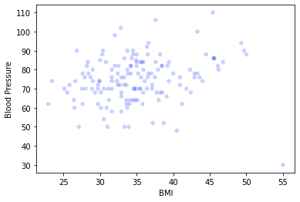
BMI vs. Blood Pressure
Covariance is 13.250088888888888
Pearsons correlation is 0.19437478953285856

Slide 19
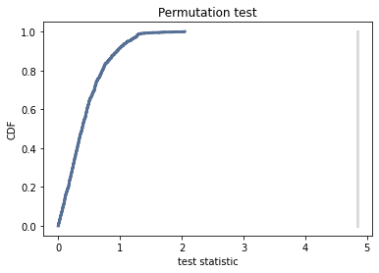
Difference in Means Permutation Test
Comparing BMI results between diabetic and nondiabetic women.
The p-value is less than 0.001 meaning that we wouldn't expect to see a result if BMI was the same among diagnosed and undiagnosed individuals. The effect is statistically significant meaning that the populations have different means.

Slide 20
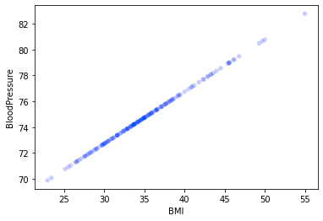
Regression Analysis of BMI vs. Blood Pressure for Diagnosed Women

Slide 21
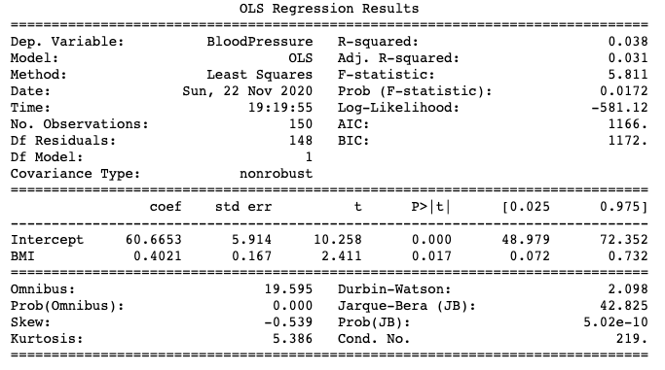

Slide 22
In Summary
With a p-value of 0.072, we can conclude that the slope of the regression is statistically significant and unlikely to have occurred by chance. This allows us to conclude that BMI and blood pressure for diagnosed women are correlated.

